Slide 1
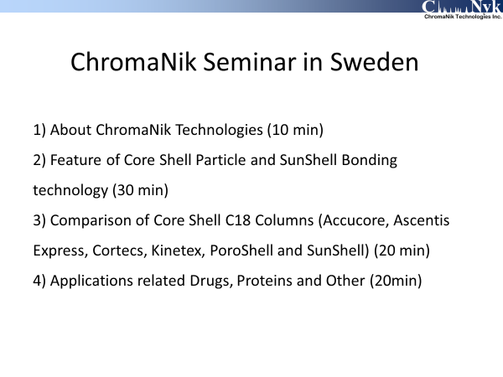
Notes:
Thank you for giving me an opportunity to talk about our product Core Shell column SunShell.

Slide 2
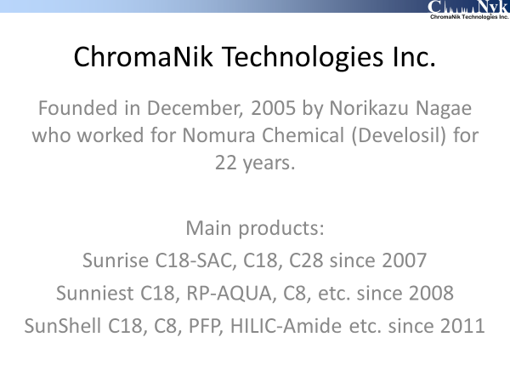
Notes:
At first, I’d like to introduce me and my company. I founded ChromaNik Technologies Inc. in December 2005. Before founding ChromaNik, I worked for Nomura Chemical for 22 years. Nomura Chemical is HPLC column manufacturer in Japan and their brand of HPLC column is Develosil.
ChromaNik developed Sunrise C18 and C28 in 2007. Then Sunniest C18 RP-AQUA and C8 in 2008. Finally Core Shell SunShell column in 2011.

Slide 3
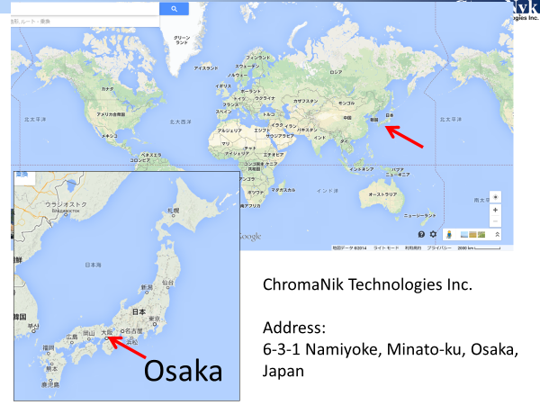
Notes:
I show the location of our company ChromaNik Technologies Japan and Osaka is located here.

Slide 4
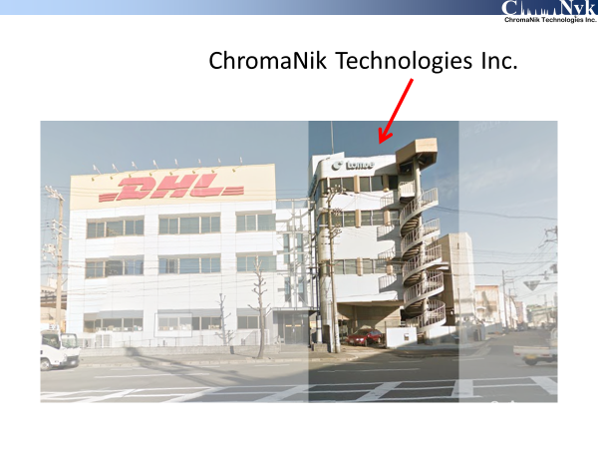
Notes:
Our office and lab are in this building.

Slide 5
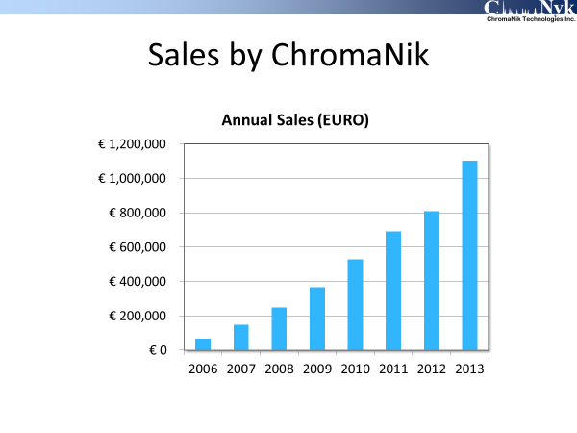
Notes:
This slide shows transition of sales proceeds.

Slide 6
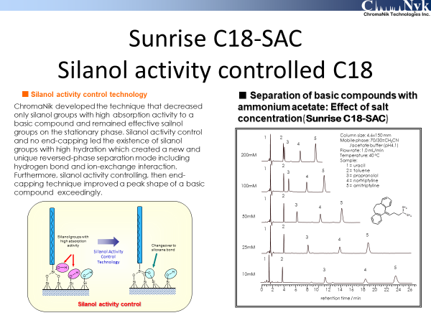
Notes:
I explain Sunrise c18-SAC shortly. This is a silanol activity controlled C18. And this is not end-capped. These red silanols have a high activity because silanol near C18 can’t hydrate enough. I changed from silanol groups to siloxane bonding with heat (like this). These chromatograms are separation of toluene and basic compounds such as amitriptyline. When concentration of salt increases, retention time of basic compounds decrease. This means that a cation exchange interaction occurred. However, (blue and hydrated) silanol group doesn’t make a basic compounds peak be tailing. (these basic compound peaks are excellent.

Slide 7
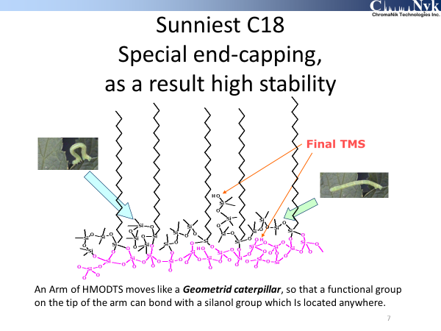
Notes:
This slide describes end-capping of Sunniest C18. Hexa-methyl- trisiloxane is used as an end-capping reagent. Furthermore tri-methyl-silyl end-capping is added.
SunShell is applied the same end-capping. This end-capping leads high stability and s a long column life.

Slide 8
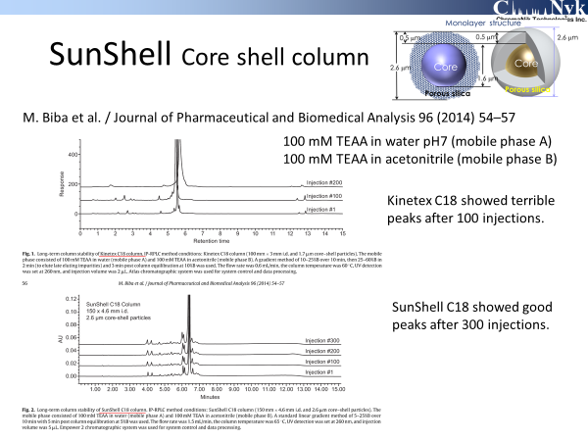
Notes:
A scientist of Merck compared the stability of core shell C18 columns Kinetex and SunShell under ion-pair reversed phase chromatography. The result was that more than 300 injections were achieved on SunShell C18, while less than 100 injections on Kinetex C18,

Slide 9
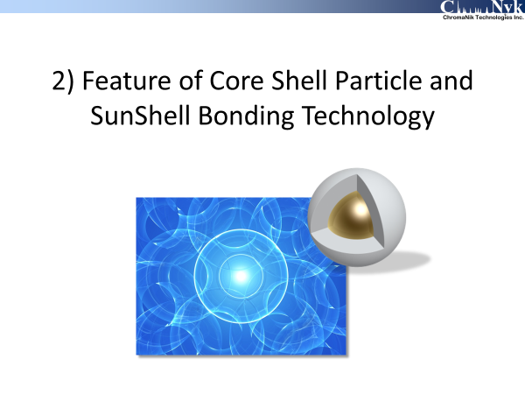
Notes:
Next I’d like to talk about Feature of Core Shell Particle and SunShell Bonding Technology.

Slide 10
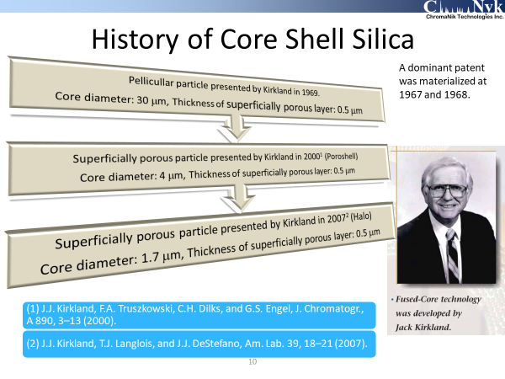
Notes:
Do you know History of Core Shell Silica? More than 40 years ago, very famous scientist Kirkland presented Pellicular particle. This was a first core shell silica. Its core was made of a glass bead and the diameter was 30 um and thickness of superficially porous layer was 0.5 um. A core size was very big, so that expected performance could not be achieved. A dominant patent concerning core shell particle was materialized at 1967 and 1968.
Then 14 years ago Kirlkand presented second generation core shell. It is called PoroShell and used for separation of proteins.
Finally 7 years ago, Kirkland presented 2.7um particle size core shell, which has the same performance as a sub 2 um fully porous particle. However regarding a back pressure, 2.7um core shell particle showed a half bak pressure to compare with sub 2 um fully porous particle.

Slide 11
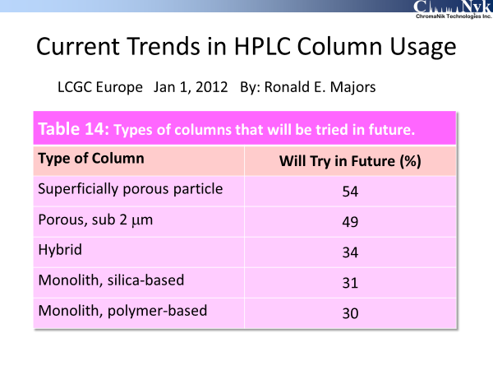
Notes:
Dr Majore presented “Current trends in HPLC column usage” on LCGC Europe 2 years ago. Interest of superficially porous particle was top and second was Porous sub 2 um. Most chromatographers watch a core shell particle, core shell technology and a core shell column.

Slide 12
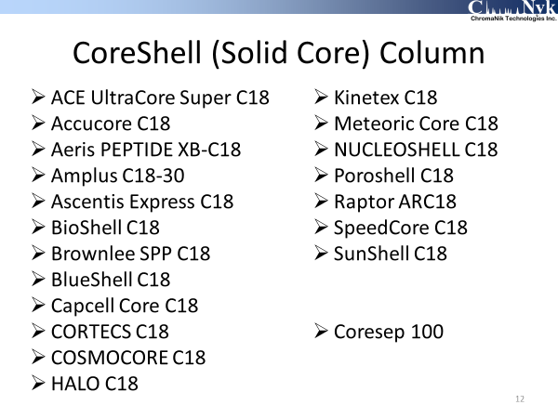
Notes:
Now 20 kinds of core shell columns are marketed. SunShell is my brand.

Slide 13
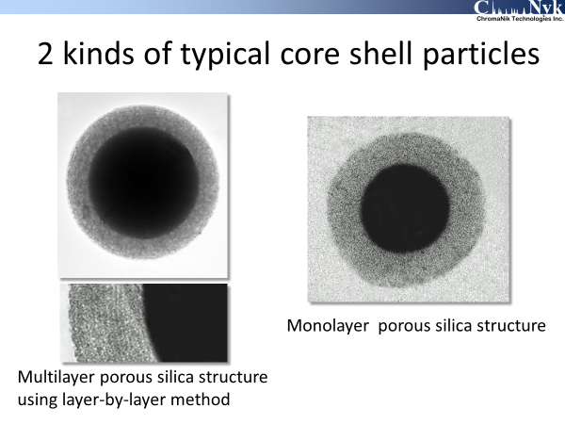
Notes:
This slide shows 2 kinds of typical core shell particles. Left one is multylayer porous silica structure and right one is monolayer porous silica structure. Kinetex is multylayer porous silica. The other brand may be monolayer porous silica.
Multilayer porous silica structure seems like an annual ring. This means ununiformity. Monolayer porous silica structure seems to be better as a packing materials for HPLC or UHPLC. Indeed I found big difference between monolayer porous structure SunShell and multilayer porous silica structure Kinetex as mentioned later.

Slide 14
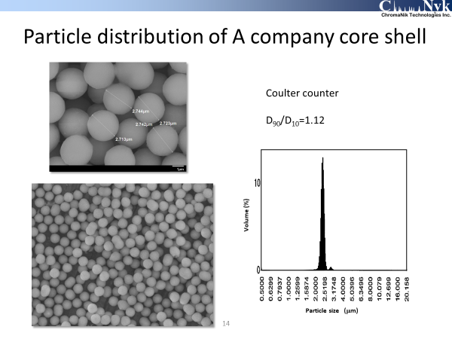
Notes:
This slide shows particle size distribution of a typical core shell silica . As you can see on photos and a figure measured by coulter counter, particle size distribution is very narrow. We can find some dimer which grew on two particle combined. All core shell silica particle include some dimers.

Slide 15
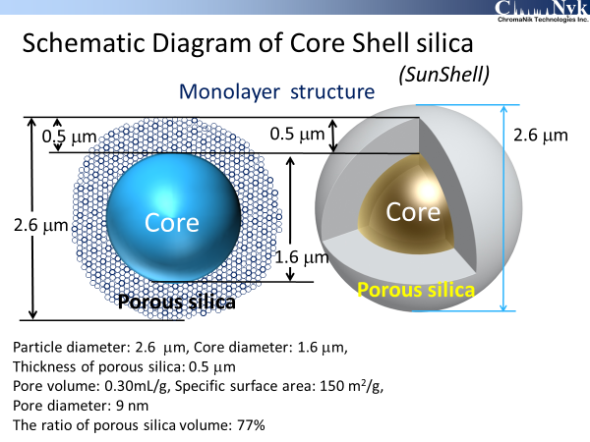
Notes:
This slide shows a structure of our core shell particle, SunShell. Particle diameter is 2.6 um. A core diameter is 1.6 um. A thickness of porous silica layer is 0.5 um. Pore volume is 0.3 mL/g. Specific surface area is 150 m2/g. Average pore diameter is 9 nm. Finally the ratio of porous silica volume is 77%.

Slide 16
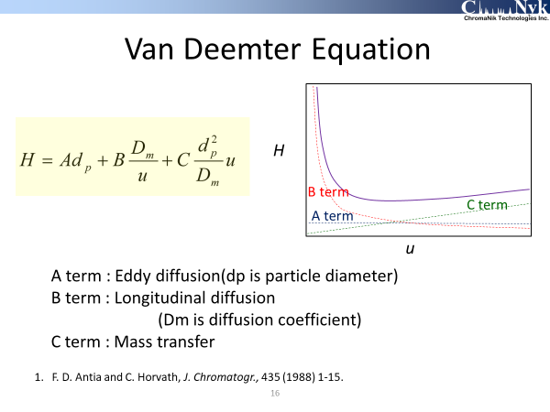
Notes:
This is Van Deemter equation and Plot. H is height equivalent to a theoretical plate. U is a linear velocity.
A term is ……..
B term is …….
C term is ……

Slide 17
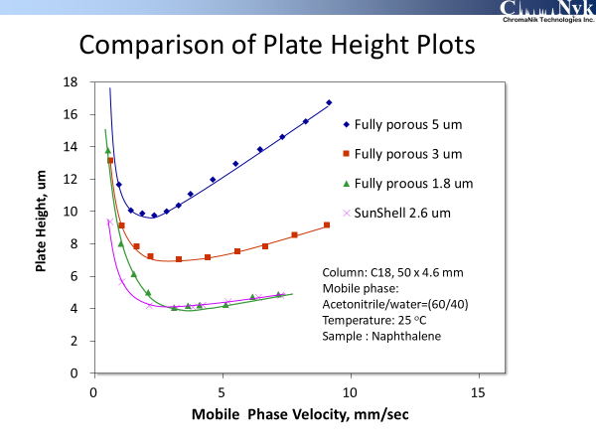
Notes:
I compared fully porous 5 um, 3um 1.8um silica C18 and 2.6 um core shell, SunShell C18 on Van Deemter plots. The smaller a particle size, the lower a plate height, This result is theoretical. However, 2.6 um core shell C18 showed almost the same plate height as 1.8 um fully porous C18. It is said that Core shell structure and narrow particle distribution make plate height low.
C term is almost the same for both 1.8 um fully porous C18 and 2.6 um core shell C18. Both A term and C term are dependent upon a particle size, but B term is independent upon a particle size. Plot at small mobile phase velocity is different between fully porous 1.8um and core shell 2.6um. . 2.6um core shell C18 plot swells more than 1.8 um fully porous C18. This result demonstrates that B term of core shell C18 is deceasing.

Slide 18
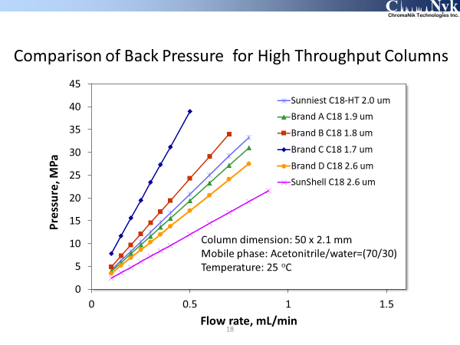
Notes:
This slide shows a back pressure of sub 2um particles and 2.6 um core shell particle.
SunShell C18 showed a half back pressure to compare with sub 2 um and 2 um other brand C18s.

Slide 19
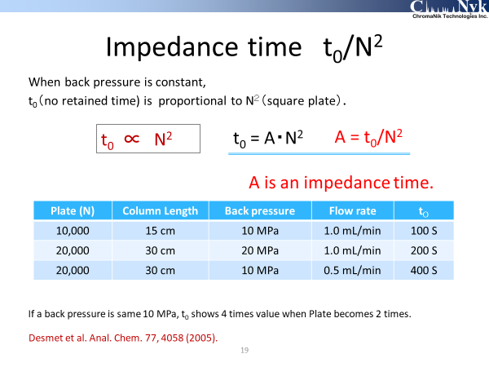
Notes:
This slide shows Impedance time, t₀/N².
When back pressure is constant, t0 is proportional to N2(square N). Constant “A” is t₀/N².
When we used 4.6 mm i.d. and 15 cm length column at 1.0 mL/min of flow rate, we could obtain that back pressure was 10 MPa, plate was 10,000 and t0 was 100 second. In case of 30 cm column length, plate became 2 times higher 20,000 and back pressure also became 2 times higher. Back pressure have to keep the same, so that flow rate should be a half. In the result t0 became 4 times longer from 100 second to 400 second.
When plate becomes 2 times, t₀ becomes 4 times under the same backpressure condition.

Slide 20
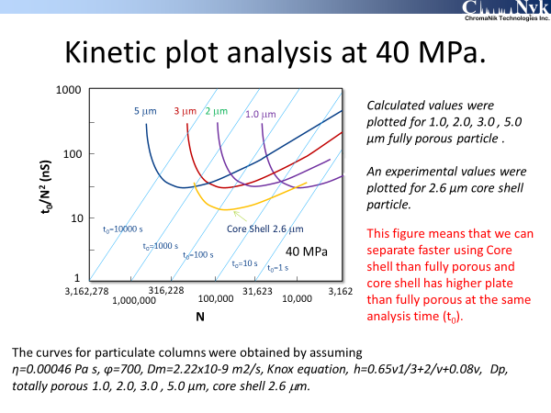
Notes:
This slide demonstrates kinetic plot analysis at 40MPa.
Vertical axis is t₀/N², impedance time. Horizontal axis is logarithm N. Regarding 1um, 2um, 3um and 5um fully porous particle, these curves were plotted by calculated values. 2.6um core shell particle curve was plotted by experimental values.
As you can see, there are a lower limit for all fully porous particles. It is 30 nano second like this. However core shell particle curve is plotted under this lower limit. This means that a core shell particle can separate faster, or at the same retention time a core shell particle shows a higher plate.

Slide 21
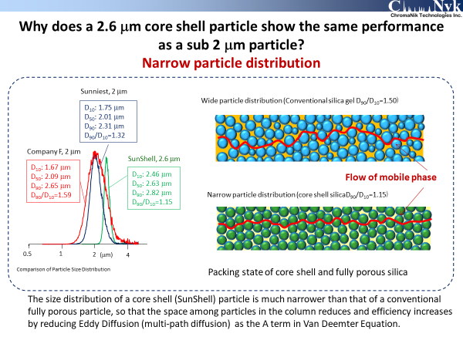
Notes:
Core shell particle generally has a narrower particle distribution than conventional fully porous particle. A narrow particle distribution allows to pack with particle into a column densely. So, a space among particles is smaller in core shell particle than in fully porous particle. As the result Eddy diffusion decreases and A term reduces for core shell particle.

Slide 22
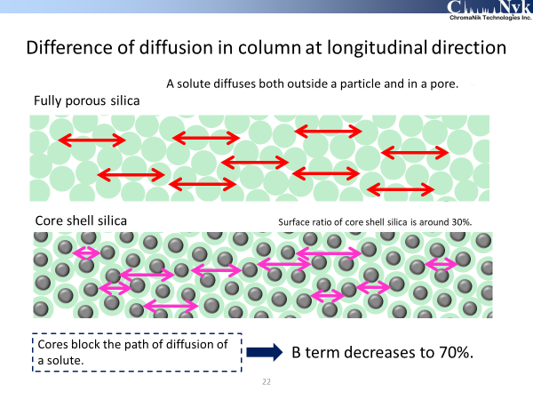
Notes:
This slide shows the reason why B term decreases for a core shell particle. A solute diffuses not only outside a particle but also in the pore of a particle. The core is a solid, so that the core blocks the diffusion of a solute. As the result longitudinal diffusion of a core shell is smaller to compare with fully porous particle.

Slide 23
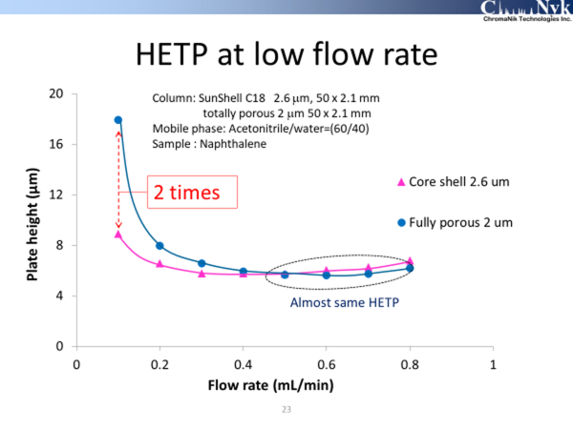
Notes:
This slide shows Van Deemter plot using a core shell particle and a fully porous particle. At around 0.6 mL/min flow rate, both particles showed an almost same plate height. But at low flow rate 0.1mL/min, the difference between both was 2 times. This result is that B term is smaller for a core shell particle than for a fully porous particle.

Slide 24
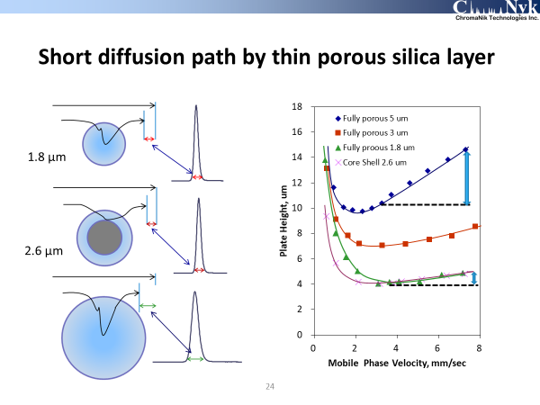
Notes:
This slide shows diffusion pass length in the pore.
A solute moves in a porous particle and a porous layer by diffusion. Diffusion path length is dependent on the particle size for a fully porous particle. However, a core shell particle consists of a core and a porous layer, so that as shown in this slide, diffusion path length is almost same on a 2.6um core shell particle and a 1.8 um fully porous particle. As a result, C term is almost same too.
These results in some slides mean that A, B and C , all terms of a core shell particle is smaller to compare with a conventional fully porous particle.

Slide 25
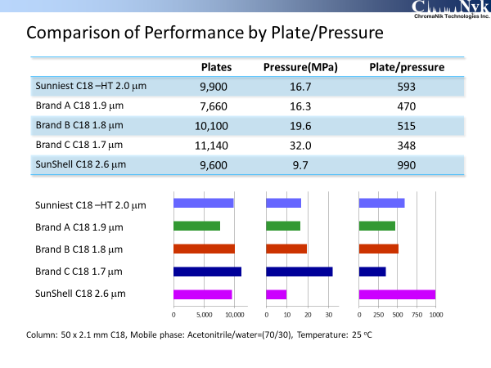
Notes:
Back pressure and theoretical plate were compared for 2 um and sub 2um C18 and 2.6 um SunShell C18. All columns showed almost the same theoretical plate except for brand A C18 1.9 um. However back pressure was not same. Especially Brand C C18 1.7um showed the highest back pressure. And SunShell C18 2.6 um showed the lowest back pressure. On the comparison of theoretical plate per back pressure, SunShell indicated the largest value. This is a big advantage.

Slide 26
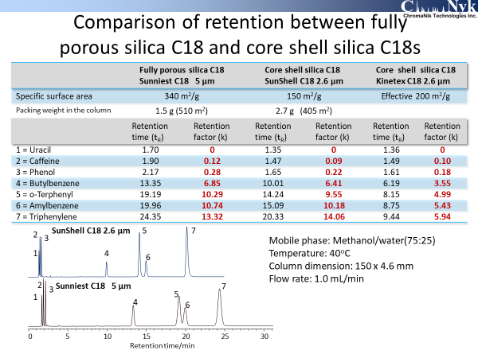
Notes:
This slide shows comparison of retention between a fully porous C18 and core shell C18s.
When we compare a total surface area of packings in the column, 340 m²/g x (multiplied by) 1.5 g = (is) 510 m² for fully porous Sunniest C18, while 150 m²/g x 2.7 g = 405 m²
for core shell SunShell C18. SunShell C18 has 80% surface area to compare with Sunniest C18, so that SunShell C18 shows 80% in retention time.
Regarding t₀ as a elution time of uracil, SunShell showed only 1.35 min while Sunniest showed 1.70 min because SunShell has a core. So retention factor is almost same for both SunShell and Sunniest. However, Kinetex C18 shows almost a half retention to compare with SunShell C18.

Slide 27
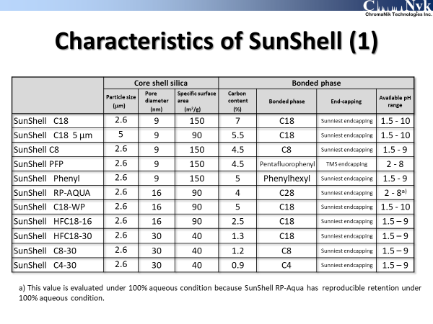
Notes:
I show SunShell phases. Not only C18 but also PFP, Phenyl, RP-AQUA, C8 and C4 are available now.
SunShell phases are end-capped using Sunniest end-capping technique except for PFP. Only PFP is end-capped with TMS.

Slide 28
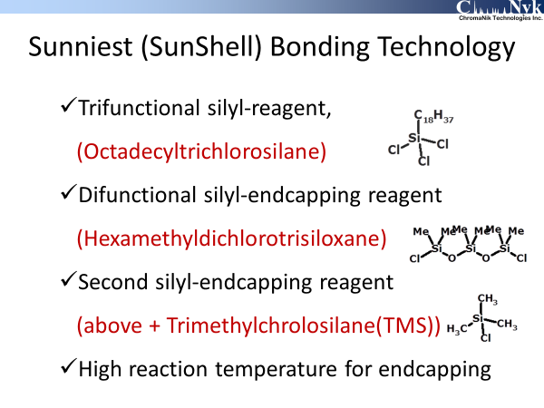
Notes:
I show Sunniest and SunShell bonding technology using a few slides.
This is a main silyl-reagent, tri functional silyl-reagent.
These two are end-capping reagents. Difunctional silyl-endcapping reagent and furthermore as an additional reagent, monofuctional endcapping reagent.

Slide 29
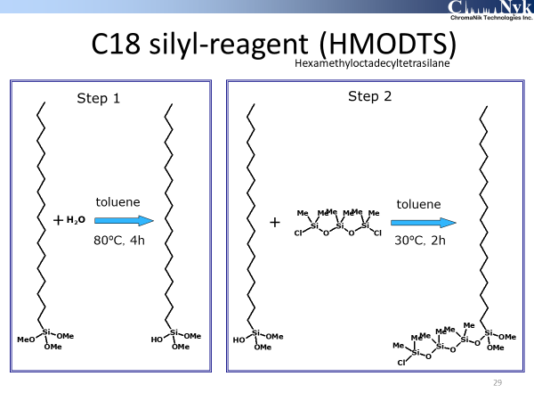
Notes:
At first, special C18 silyl-reagent (HMODTS) was synthesized. Trifunctional C18 reagent was used. Then hexamethyl dichlorotrisiloxane was bonded to C18 reagent.
This special C18 reagent was bonded on the silica surface.

Slide 30
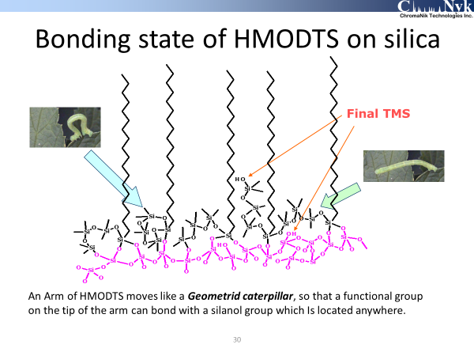
Notes:
An end-capping part of HMODTS works as an arm. This arm moves like a Geometrid caterpillar, so that a functional group on the tip of the arm can bond with a silanol group which is located anywhere.
Finally TMS reagent is bonded to a remaining silanol group.
This end-capping technique makes residual silanol groups the least. So SunShell C18 shows the least tailing peak for a basic compound and the highest stability.

Slide 31
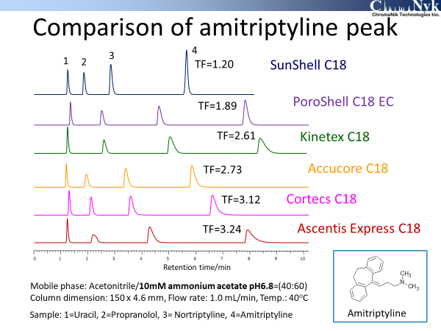
Notes:
This slide shows comparison of amitriptyline peak using acetonitrile and 10mM ammonium acetate mobile phase. SunShell C18 showed a good peak. But the other C18s showed a tailing peak. Tailing factor TF is also described.

Slide 32
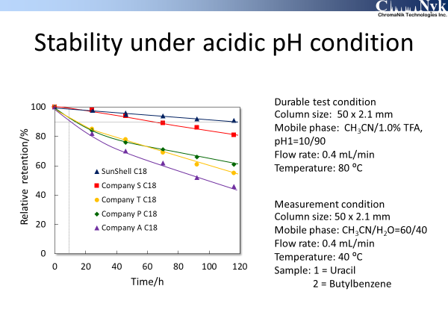
Notes:
This slide shows stability under an acidic pH condition.
Durable test condition is 1.0% TFA, pH 1 and 80 degree Celsius which is high temperature. This is an accelerated condition. Under acidic pH condition, C18 chain is cut off by hydrosis. Then retention time decreases. ShunShell C18 was the most stable.

Slide 33
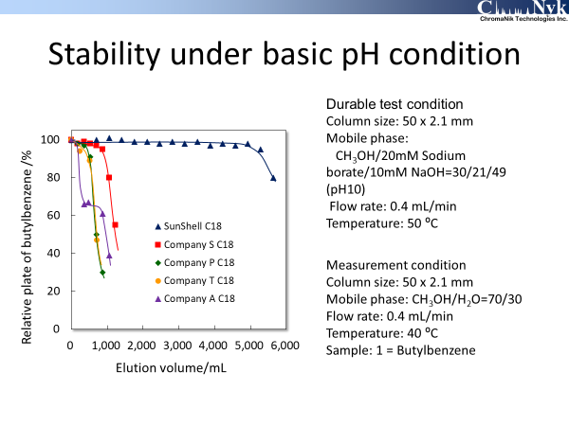
Notes:
This slide shows stability under basic pH condition. Durable test condition is pH 10 using sodium borate and 50 degree Celsius.
Under basic pH condition, silica is dissolved by hydrosis, so that plate decreases. SunShell was the most stable.

Slide 34
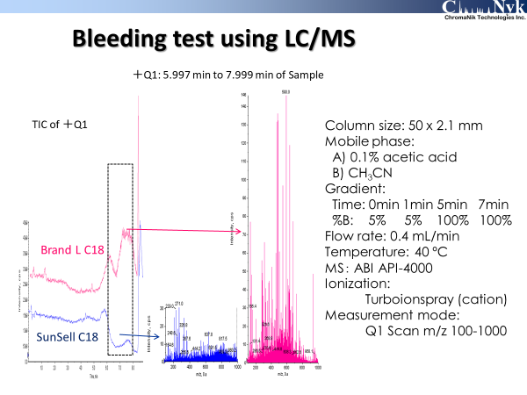
Notes:
This slide shows a bleeding test using LC/MS. Mobile phase is 0.1% acetic acid and acetonitrile. A gradient program is like this.
Left is total ion chromatograms and right is total mass spectra from 6 minute to 8 minute. SunShell C18 shows lower spectrum.
Bleeding from SunShell C18 column is very low to compare with a conventional C18.

Slide 35
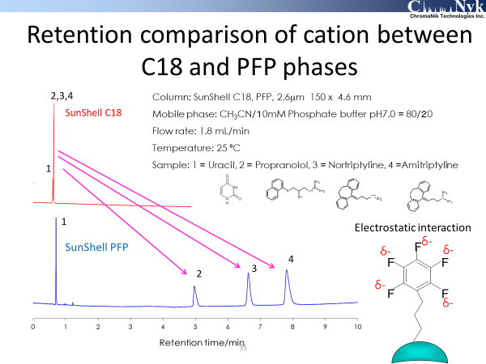
Notes:
This slide shows separation of basic compounds using SunShell C18 and PFP columns.
These basic compounds are protonated under a neutral pH condition. Mobile phase includes 80% acetonitrile. This is very high concentration of an organic solvent. SunShell C18 retains little for all samples. However SunShell PFP retains basic compounds very much. Dipole-dipole interaction is working on PFP phase. Deflection of electron to florine makes basic cation, a protonated basic compound retain on a stationary phase. This is an electrostatic interaction not a cation exchange.

Slide 36
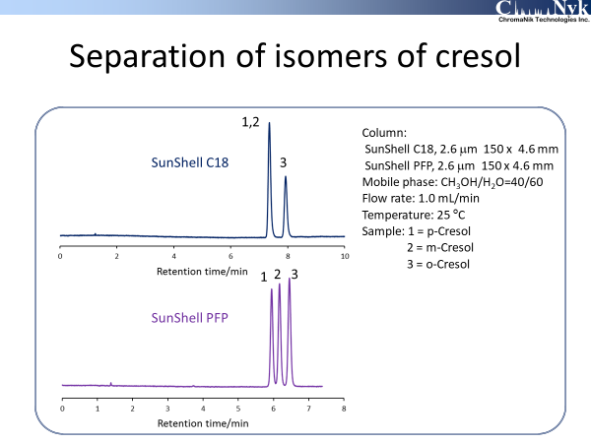
Notes:
PFP phase can separate isomers of cresol. C18 phase can’t separate p-, m-cresol. But PFP can perfectly separate them.

Slide 37
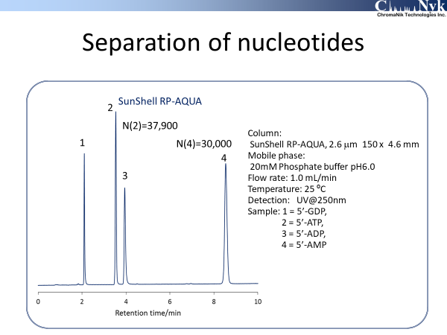
Notes:
This is separation of nucleotides using SunShell RP-AQUA column under 100% aqueous condition.

Slide 38
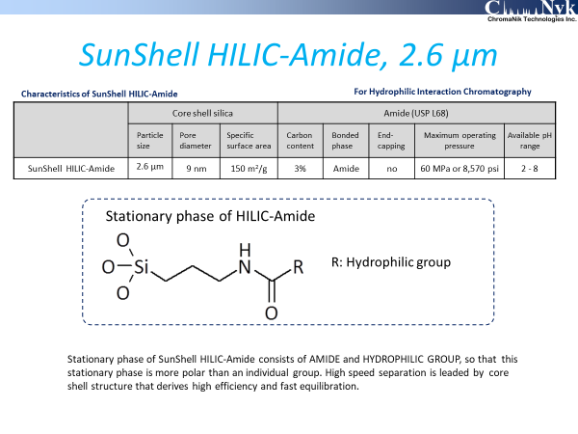
Notes:
I introduce our HILIC column and applications using a HILIC column. SunShell HILIC-Amide phase consists of amide and hydrophilic groups. This hydrophilic group is monosccharide. Our HILIC phase is very polar, so that it retains well.

Slide 39
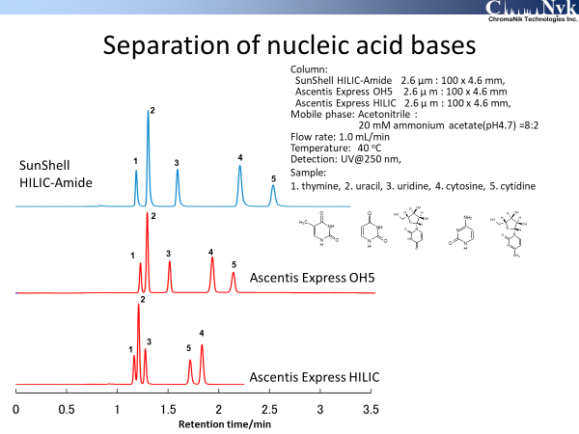
Notes:
This slide shows comparison of retention time of nucleic acid bases. I used SunShell HILIC-Amide, Ascntis Express OH5 and Ascentis Express HILIC. Ascentis Express HILIC is just a bare silica not bonded. Cortecs HILIC and Kinetex HILIC are same just a bare silica. SunShell HILIC-Amide showed the longest retention time. A long retention time is an advantage for HILIC separation.

Slide 40
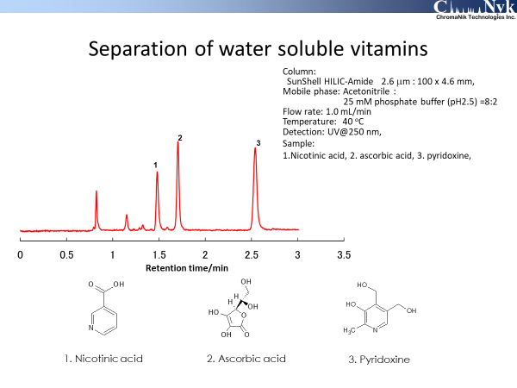
Notes:
This slide shows a separation of water-soluble vitamins, nicotinic acid, ascorbic acid and pyridoxine.

Slide 41
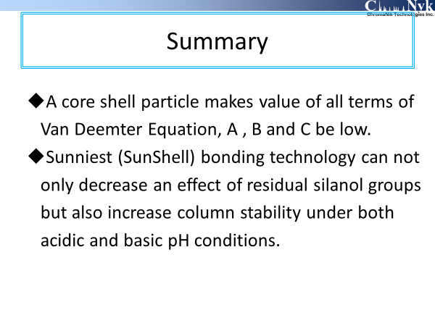
Notes:
As a summary until now.

Slide 42
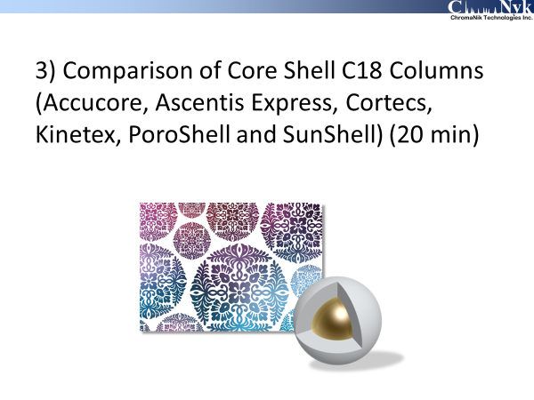
Notes:
I talk about comparison of core shell C18 columns.

Slide 43
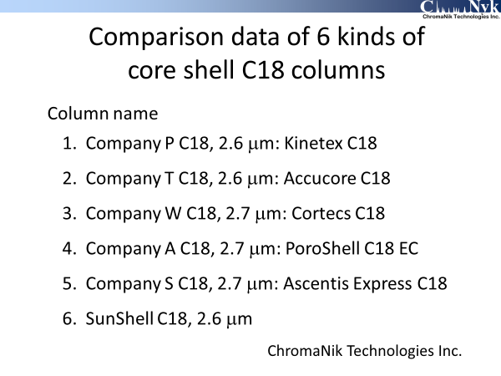
Notes:
I evaluated Kinetex C18, Accucore C18, Cortecs C18, Poroshell C18 EC, Ascentis Express C18 and SunShell C18.

Slide 44
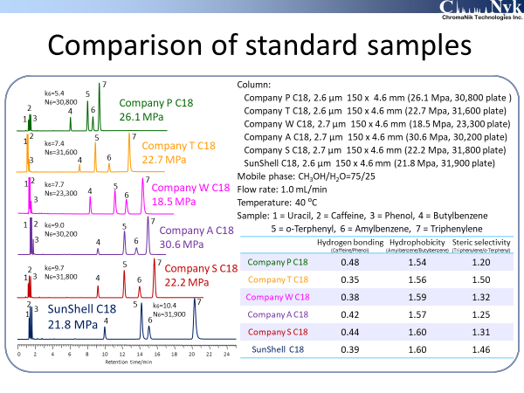
Notes:
This slide shows comparison of standard samples. Samples are uracil, caffeine, phenol, butylbenzene, o-terphenyl, amylbenzene and triphenylene.
I obtained hydrogen bonding capacity, as separation factor of caffeine and phenol, hydrophobicity as separation factor of amylbenzene and butybenzene, steric selectivity as separation factor of triphenylene and o-terphenyl. I also measured back pressure, retention factor and theoretical plate. Company W C18 showed not only the lowest back pressure. But also the lowest theoretical plate. Company P and A C18s showed higher back pressure.

Slide 45
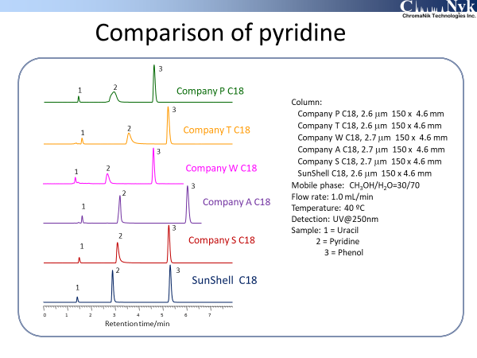
Notes:
This slide shows comparison of pyridine. Company A and SunShell C18 showed a good peak. But the other C18s showed a tailing peak.

Slide 46
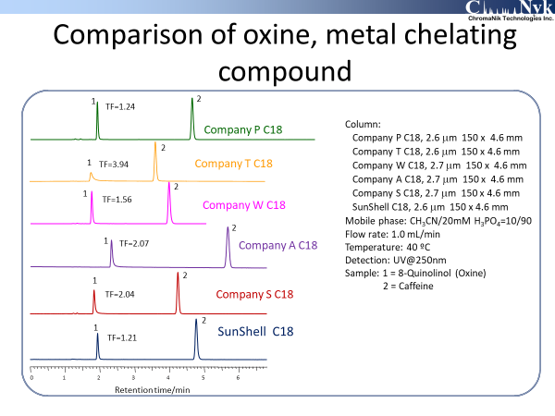
Notes:
This slide shows comparison of metal chelating compound, Oxine.
Company P C18 and SunShell C18 showed a good peak. Company W C18 showed a pretty good peak. The other C18s showed a tailing peak.

Slide 47
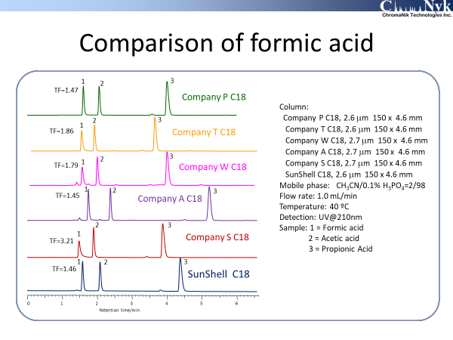
Notes:
This slide shows comparison of formic acid. Almost C18s shows a good peak for acetic acid and propionic acid. However regarding formic acid, some C18s show a tailing peak. Company P and A C18 and SunShell C18 showed a good peak. The other C18 showed a tailing peak.

Slide 48
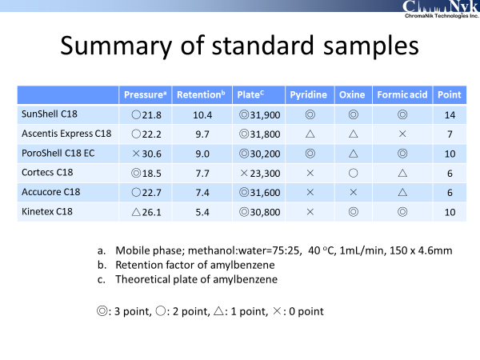
Notes:
I summarized comparison of standard samples.
I put a point for each item in the column. I put the order. I have ranked these columns.

Slide 49
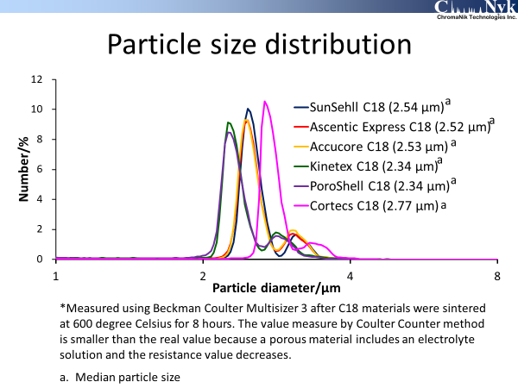
Notes:
After evaluation of core shell columns, I took packing materials out of each column and measured carbon loading. Furthermore I sintered these packing materials at 600 degree Celsius for 8 hours. As a core shell silica, I measured particle size distribution using Beckman Coulter Multisizer 3. Coulter counter method is to measure resistivity when one particle passes through the aperture in the electrolyte solution. A porous material includes electrolyte solution in the pore, so that resistivity becomes smaller. Then a measured value is smaller than the true value.
As you can see, PoroShell and Kinetex showed smaller size. And Cortecs showed larger size. In the previous slide, Cortecs showed the lowest back pressure and the lowest theoretical plate because a particle size is the largest.

Slide 50
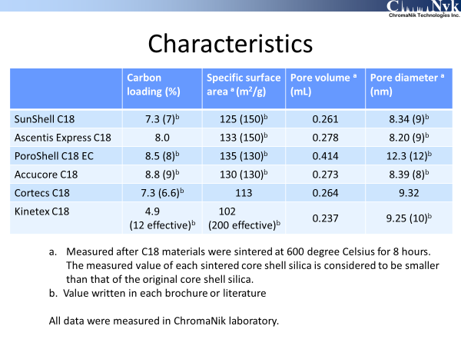
Notes:
I measured not only carbon loading but also specific surface area, pore volume and pore diameter shown in this slide. The value in a parentheses is written in each brochure or literature. Except for Kinetex C18, The measured value is almost same as the value written in each brochure or literature.
In comparison of standard samples, kinetex C18 showed a half retention time to compare with SunShell C18. From measured value carbon loading and specific surface area of Kinetex C18 is only 4.9% and 102 m2/g respectively. So A half retention time for Kinetex C18 is naturally. Pnenomenex showed effective carbon loading and effective surface area, not specific surface area.

Slide 51

Notes:
This slide is one page of Kinetex brochure.

Slide 52

Notes:
Phenomenex printed 200 m2/g and 12% as Effective surface area and effective carbon load. But nobody knows what “effective” means.

Slide 53

Notes:
A certain chemist wrote a paper. He didn’t distinguish between effective and specific surface area. This table gives a misunderstanding to a reader.

Slide 54

Notes:
I compared loading capacity and a peak shape of amitriptyline as a basic compound using acetonitrile and 10 mM phosphate buffer pH7. Regarding amitriptyline peak, SunShell and company A C18 showed a good peak. However the other C18s showed a tailing peak. The vertical axis is theoretical plate and the horizontal axis is logarithm sample weight. Regarding SunShell C18, more than 1 μg is sample over loading so that Theoretical plate decreased over 1 μg. Regarding Company P, Kinetex C18, more than 0.01 μg is sample over loading. The difference between SunShell and Kinetex C18 is 100 times. I heard from many chromatographers that sample loading capacity of a basic compound for kinetex C18 was very low. This result is the same as opinions of customers. The reason of this phenomenon may be due to multilayer structure of porous silica. (I don’t know the truth. This is just my speculation.)
Company T and W, Accucore and Cortecs C18 showed a strange behavior.

Slide 55

Notes:
This slide shows chromatograms of company T, Accucore C18. Exactly these chromatograms showed that the peak loaded 5 μg is shaper than the peak loaded 0.3 μg.

Slide 56

Notes:
In this slide I changed a buffer from sodium phosphate to ammonium acetate. I obtained the almost same result as a previous one. SunShell C18 showed a good peak for amitriptyline and the other C18s showed a tailing peak.

Slide 57

Notes:
I compared loading capacity of amitriptyline under 0.1% formic acid condition. It is said that 0.1% formic acid is low ionic strength, so that loading capacity is much lower under 0.1% formic acid than under 0.1% TFA.
The vertical axis is USP tailing factor. SunShell C18 and company A PoroShell C18 showed high loading capacity.

Slide 58

Notes:
This slide shows stability under acidic pH condition. The upper is a durable test condition. Mobile phase is acetonitrile and 1.0% TFA pH1 (10 to 90). Temperature is 80 degree Celsius. This condition is accelerated. As a comparison at 90% of relative retention, SunShell C18 showed 120 hours, Company S, Ascentis Express C18 showed 60 hours, company W, Cortecs C18 showed 25 hours and the other C18s showed only 10 hours.
SunShell C18 showed 10 times more stable than Kinetex and PoroShell C18.

Slide 59

Notes:
This slide shows stability under basic pH condition. Durable condition is this. Mobile phase is methanol and 20 mM sodium borate and 10mM sodium hydroxide (30 to 21 to 49) pH 10. Temperature is 50 degree Celsius. Under basic pH condition, C18 is deteriorated by dissolving silica gel and a void yields in the column so that theoretical plate decreases. Vertical axis is relative theoretical plate.
SunShell C18 can be used by 5000 mL of elution volume. SunShell C18 is 10 times more stable than Kinetex C18 under basic pH condition as well as acidic pH condition.

Slide 60

Notes:
This is a summary of stability. There is a big difference between the experimental result and the value written in the brochure.

Slide 61

Notes:
This is a summary of 6 kinds of core shell C18s.

Slide 62

Notes:
I demonstrate some applications related drags, proteins and the others.

Slide 63

Notes:
This is separation of amino acids derivatized with OPA and FMOC using SunShell C18 column. 16 kinds of primary amino acids and one secondary amino acid are perfectly separated.

Slide 64

Notes:
This is also separation of amino acids, not derivatized and detected using MS. SunShell RP-AQUA column was used.
I used Hepta-fluoro-butylic acid as an ion-pair reagent and gradient elution. Precise mass was measured and 20 kinds of amino acids was separated.

Slide 65

Notes:
This slide shows separation of organic acids. I compared SunShell RP-AQUA and Ascentis Express C18 AQ (red one). SunShell RP-AQUA showed good peaks while Ascentis Express C18 AQ showed a bad peak for No.1 oxalic acid and No.8 Maleic acid. It is considered that a metal impurity made these two acids broadening.

Slide 66

Notes:
This slide shows Azithromicyn related substances test. This test is checking impurities in Azithromycin as a drag. HPLC conditions is very tough, pH 9 mobile phase and 60 degree Celsius. Number 4 peak is Azithromycin and the concentration is over 98 %. A Certain pharmaceutical company compared Waters X-Bridge C18 and Sunniest C18 for this test. As the result, X-Bridge C18 could work for 30 injections, while Sunniest C18 for 25 injections. The difference between both was a little, although Sunniest C18 is made of just silica gel not hybrid silica particle.

Slide 67

Notes:
This is condition for azithromycin related substances test. Used columns are Waters Xbridge C18 and SunShell C18. Column dimension is different because of different particle size. Injection volume is also different and in proportional to column volume. Bonding chemistry on SunShell is the same as that on Sunniest, so that Stability is same for both.

Slide 68

Notes:
This is a profile of gradient program. In consideration of column volume and flow rate, gradient time for SunShell was one fifth to compare with Xbridge.

Slide 69

Notes:
These are chromatograms for azithromycin related substances teat. Blank chromatogram, sample chromatogram at 92nd injection. We could confirmed that more than 90 of analysis of azithromycin was achieved on SunShell C18.

Slide 70

Notes:
This slide shows separation of Erythromycin Estolate. LC condition is also basic pH 8 and high temperature 65 degree Celsius. This is chromatographic purity test too. I used Sunniest C18 column. Next a few slides shows Sunniest. Bonding chemistry is same for both Sunniest and SunShell, so that I believe that SunShell column can be applied in these applications.

Slide 71

Notes:
This slide shows separation of antihistamins using Sunniest C18 column. I compared two mobile phase. One is acetonitrile and phosphate buffer , another is acetonitrile and ammonium acetate. The latter is used under LC/MS. These basic compounds especially number 3 peak Clemastine often shows a tailing peak. However Sunniest column showed a symmetrical peak.

Slide 72

Notes:
This slide shows separation of analgesics using Sunniest C18. The upper chromatogram used phosphoric acid and the lower one used formic acid. Under both conditions, all peaks are excellent.

Slide 73

Notes:
This slide shows separation of lumazine and related substances using Sunniest RP-AQUA column. These samples are highly polar, so that 100% aqueous solution was used as a mobile phase. Our RP-AQUA phase is C28, long alkyl chain. This long alkyl chain doesn’t include a polar part in stationary phase, so that Sunniest or SunShell RP-AQUA is much stable and has longer column life than the C18 AQ column.

Slide 74

Notes:
This slide show stability of aqua type reversed phase columns under acidic and weak basic pH aqueous condition. Sunniest RP-AQUA showed more than 3 times higher stability than aqua type C18.

Slide 75

Notes:
This slide shows separation of salbutamol sulphate and related substances using Sunniest C8 column. This separation is used gradient elution. This is evaluated by a customer. I feel that triethylamine is not needed because Sunniest has little residual silanol groups.

Slide 76

Notes:
This slide shows separation of leuprolide acetate using SunShell C18 column. The peaks except for main big one are impurities. This separation is gradient elution too.

Slide 77

Notes:
This slide shows LC/MS separation of dansylated estrogen hormones using SunShell C18 column. Mobile phase is 0.1 % formic acid solution and acetonitrile. 4 kinds of estrogen hormones were separated.

Slide 78

Notes:
This slide shows separation of ethambutol hydrochloride and impurity usong SunShell C18 column. Methanol and water were used as a mobile phase and gradient separation was achieved.

Slide 79

Notes:
This slide shows separation of arbutin and related substanxes using SunShell RP-AQUA column. 2 kinds of mobile phases were used. One is formic acid and methanol. Another is phosphoric acid and methanol. Under both conditions almost same separation was achieved.

Slide 80

Notes:
This slide shows separation of purine analogue using SunShell RP-AQUA, uric acid, hypoxanthine, xanthine, Oxipurinol and allopurinol. This separation was also used 2 kinds of mobile phase. One is ammonium actate solution. Another is phosphate buffer solution. Almost same separation was achieved under both conditions although elution order of an impurity as a small peak was different.

Slide 81

Notes:
From Now on, I talk about applications of peptides and proteins. Our SunShell phases are listed in the table. Regarding particle size and the thickness of porous layer, all phases except for prototype are same. Pore diameter is 16 nm and 30 nm. HFC18 is a half C18 surface coverage. Especially a half coverage of C18 is good for separation of proteins. High density C18 is too hydrophobic to separate proteins.
Regarding Prototype C8 core shell, I talk in the latter slides.

Slide 82

Notes:
This slide shows separation of peptides. I used 2 kinds of c18 phases. The upper one is SunShell HFC18-16, and the lower one is SunShell C18-WP. The difference of both is C18 ligand density. Sample is a tryptic digest of Cytochrome C. The separation showed a slightly different selectivity

Slide 83

Notes:
This slide shows separation of protein standard at 80 degree Celsius. SunShell C8 is used up to 80 degree Celsius. BSA and Ovalbumin is not pure, so that we can see many peaks.

Slide 84

Notes:
I compared thickness of porous layer and gradient time. When 5 minute gradient time like high throughput separation was done, Red chromatogram showed a shaper peak than blue one. In case of high through-put separation of proteins, thin porous layer has an advantage. In case of 60 minute gradient time, reversely blue chromatogram shows shaper peak than red one. Especially separation of BSA indicates much difference. This is a reason why surface area contributes separation and partition mode works, so that large surface area is an advantage for partition.

Slide 85

Notes:
I compare with two kinds of core shell particle. Even if proteins are separated under a gradient mode, partition between stationary phase and mobile phase works. So large surface area has an advantage for separation.
Thank you for your attention.

